Slide 1
Golsa, Dr. Herman Barkema, Michele and Thuntida

Slide 2
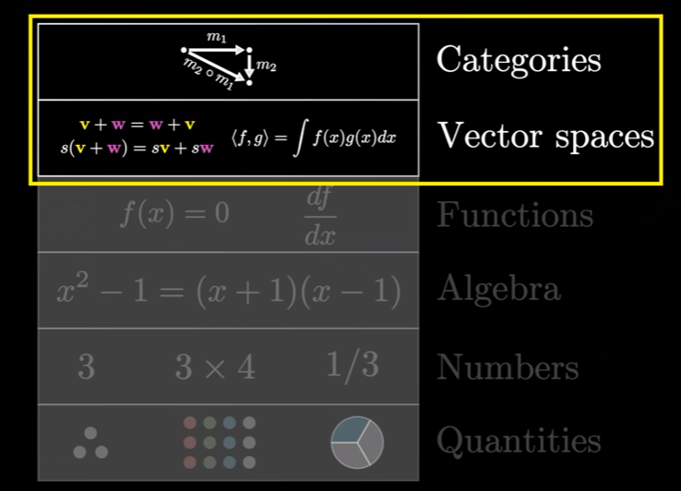
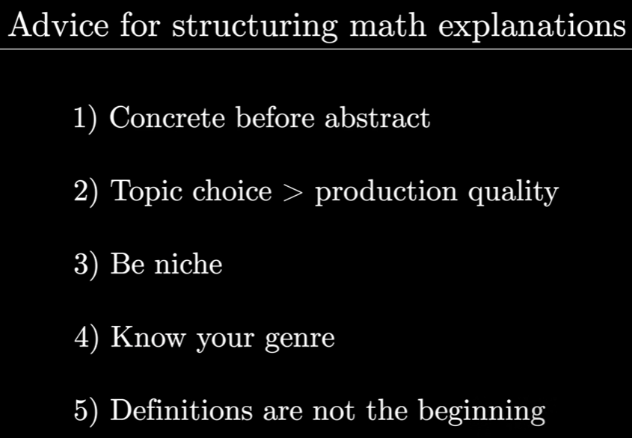

Slide 3
Greetings to students
Hello and welcome to Principles of Biostatistics! Thank you, Samantha for your kind and informative introduction.
As you know, Katie is your instructor for section I and I am your instructor for section II. We are here to support you every step of the way. Please don't hesitate to reach out to us if you have any questions or concerns. Let's have a wonderful time together!
You've probably heard a lot about this class. Now, I'd want to introduce myself briefly since you may be curious about your instructors. My name is Qing Li and I usually go by Leah. I come from China and I am a fifth-year Ph.D. student at the University of Calgary's Cummings School of Medicine. My undergraduate and master's degrees are in bioengineering, and I have my PhD study in bioinformatics. I had extensive training in statistics and data engineering during my Ph.D. studies. My research focuses on developing innovative statistical tools to solve challenges in statistical genetics fields. I have rich expertise in managing large and high-dimensional data sets using machine learning and deep learning models.
Back to the course, in part 2, Statistical Modeling with Data, I will walk you through many valuable statistical modelling techniques and methods, including model building, model selection, model evaluations, etc. In addition, I also prepared one lecture about transfer learning which is based on one of my research projects. Let's take a closer look at deep learning models, and explore some examples of transfer learning using the power of already-built models to solve in-house problems better and cheaper.
That’s pretty much from me. Enjoy today’s course and see you on May 23.
ZOOM LINK | Passcode: biostat23
Launch Meeting - Zoom

Slide 4
Questions to answer:
Can you please introduce yourself?
What motivates you to be an instructor for this course?
What are your expectations? How was a difficult case you had in your previous teaching experience?
Questions to ask:
What are the goals and aims of this workshop?
How is the workshop organized? (schedule, online/in-person)
How can we distinguish this workshop from another online course?
How about the payment?
Instructors/attendees:
What kind of instructors are you looking for? What are the instructor’s duties? Do I need to prepare teaching slides?
When am I supposed to know the interview results?
Who will be the major attendees?

Slide 5
I am a Ph.D. student from Dr. Quan Long’s lab. I am currently at the end of my 4th year, and I will turn into my 5th year in May 2023. Although my major is bioinformatics, I have had myself trained a lot in biostatistics fields. My research projects center on developing novel statistical tools to solve essential problems in statistical genetics fields. Specifically, I focus on incorporating cutting-edge machine/deep learning models with multi-omics datasets to disclose causal genetic variants.
Research projects:
In one of my research projects, we developed a model to estimate the null distribution better, and this resulted in the discovery of more genetic variants with small effect sizes. The manuscript is under review in Science Advances.
In another of my research projects, we integrated biological interactions into linear mixed models and revealed one promising functional mechanism conferring the risk of ASD. The manuscript was accepted for publication in Genomics.
I am also currently working on two very thrilling projects: one is using transfer learning to reveal more causal genetic variants, and another is using kernel smoothing methods to minimize permutation times.
TA experiences:
I didn’t do any TA in my first three years. One reason is that I am based in Cumming Medical School, and medical school students are funded by PI’s funding, and TA is an option but not a duty. Another reason is that I happened to welcome my two kids in my first three years of study. They are gifts from God, and I really appreciate the opportunity to be a mom. Even though it has been an extremely tough period to take care of newborns and continue research at the same time, I, fortunately, managed through it with support from my supervisor and my family. They are happily attending UCCC daycare now. In the summer of 2022, I decided to challenge myself a bit and take over the TA position for the course MDSC 403, Computation for Bioinformatics. Like most Tas, I answered questions from students and graded assignments and exams. I also delivered a guest lecture about Transfer Learning based on my research project in that course.
To summarize, I view myself as a responsible mom, a productive and versatile researcher who is eager to solve key problems in human statistical genetics. My career goal is to seek a faculty position in Canada and become a pioneer in the field of statistical genetics and biostatistics. I will pursue a post-doc in biostatistics after graduation, and in the meantime, I also want to do more teaching and prepare myself for assistant professor positions in biostatistics.
Notes:
What made you choose a career as a statistician?
I have always been interested in discovering what makes things work, and statistics could give me an opportunity to discover that every day in my research work. My favourite thing about working in statistical genetics is that I am never bored and always learn something new.
How do you handle conflict in a professional setting?
To be honest, I don’t have much experience managing conflicts. You know, current graduate studies always train graduate students to work independently and think critically. Sometimes, I have disagreements with my supervisor, but we can always research an agreement in the end, as we are both good listeners and open-mined.
I am confident that I can handle it smoothly in the future. The reason why I say that is because I try to always approach disagreement as an opportunity to learn. I am also a kind person who can manage their temps. In other words, I can calm myself down easily and quickly (thanks to training offered by my two kids) and then focus on things instead of feelings.

Slide 6
TA evaluations
I understand that different people have different opinions and different attitudes towards the same thing. I promise that I treat them equally, and grade all assignments without bias. One of my main objectives as a TA is to enable my students to achieve their academic goals and also to encourage them to work hard and lay down the foundations for a bright and successful future
Back in 2022, I was a junior TA, who lacked experience working with undergraduate students. But I will become mature in 2023. Being mature means I will avoid some mistakes I made in my previous TA and guide students through lectures better. Especially, I get more time as one of my manuscripts has been accepted, and another one is under review. I can graduate safely and sound. So I can spend more time and energy communicating with my students in depth if necessary.
I didn’t compare the two students’ homework. What happened is someone came to me and asked for full marks for his/her assignment. However, his/her assignment did not deserve full marks as there were a lot of unprofessional parts. I refused that student’s request for a full mark, I highlighted parts that he/she could improve and sent him/her a copy of excellent work. To my supervise, he/she felt I was comparing students’ works.
What I think I could do better in this May is to pay more attention to students who do not approach me actively. I was too busy submitting manuscripts in my last TA, so I had more communication with students who acted dynamically. That is to say, those who approached me more frequently got more assistance than others. As I mentioned before, I have one paper published, one under review and two more with promising results and it can be wrapped into manuscripts soon. Therefore, I will pay much more attention to all students, not only those active students.
Notes:
What do you like/dislike about being an instructor?
There are lots to like about teaching and, in particular, being a University instructor. My mom is a high school teacher, and she is my role model.
When I was very little, I dreamed of being someone like her or, possibly, better than her. So, I pursued a Ph.D. to accumulate research skills, and now I pursue more teaching opportunities to prepare myself as an instructor or even an assistant professor. I enjoy the challenge of preparing and organizing lectures. For me, the challenging aspect is getting the lecture prepared and also working out how to deliver the information and knowledge in an easy-to-absorb and retainable manner. I also enjoy seeing my students making progress. For me, that’s the most rewarding aspect of being an instructor.
In regard to the elements I dislike, I obviously don’t like it when students are late for class for no reason or if they are simply going through the motions and tunning up to lectures with no interest in learning. I think it’s a shame for them because they are basically wasting both my time and theirs. However, having that being said, I do see it as my responsibility to encourage students to use their time wisely at U of C, as these years are absolutely crucial to their future success in life and at work.

Slide 7
Handling students’ questions
Some of them are predictable. For example
Is there any alternative ways other than linear regression?
How to evaluate models’ performance? How to improve models’ performance?
Tips for data preprocessing? [Standardization, Minmax scaler to ensure different variables in similar scales.]
What can I do if I have a limited sample size but too many features?
For questions beyond the scope of my experience and knowledge
Note them, search for literature and answer them later. From my point of view, instructors are not Wikipedia and know the answers to every question. But he/she but have a general sense of the problem and can utilize resources to solve the problem sooner or later.

Slide 8
Questions for Data 603
Specific:
R code as well results are well displayed or organized. How long did it take for you to prepare these documents?
What kind of questions did students ask in previous workshops?
Any detailed rubrics for grading assignments?
L02 documents are R scripts and PDF, can you give me some suggestions on how to walk students through these materials?
General:
Why did you choose multivariate linear regression as the topic in data 603? Any possibility of extending to other complicated models, such as machine learning and deep learning? Are we expecting participants to have some prior knowledge? Such as CLT and hypothesis test?
When do I expect to know the interview results?
What’s the salary for the instructor and TA this year?
May I have evaluations if I will be offered as the instructor and TA for L02?
Are you guys attending JSM conference this year?
Notes:
Joint Statistical Meetings (JSM) is the largest gathering of statisticians held in North America.

Slide 9
Since we are approaching the end of this meeting, I take a moment to thank Golsa for organizing the two interviews, Dr. Herman Barkema, Michele and Thuntida and for your questions and time.
Even though this meeting is brief, I think I have demonstrated that I am an excellent candidate for this position. In summary, I am someone who has an immense passion for utilizing statistical tools to solve both research and daily problems. I am someone who has rich experience in coding and data analysis using R and python. Besides, I am also eager to impart/pass my knowledge and experience to my students and am always willing to learn from my students and assist them in achieving success in life and at work.
I really appreciate having such a great opportunity to become an instructor and TA in Data 603 and participate in the OneHealth program. I hope you all enjoy the rest of the day, and I look forward to the interview results.

Slide 10
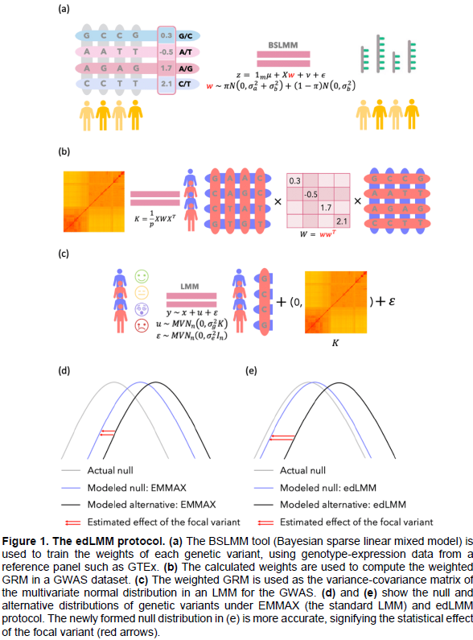
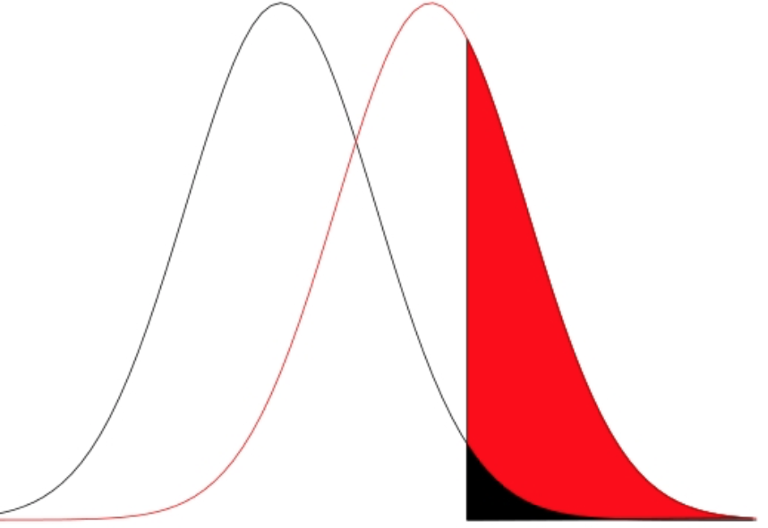
H0
H1
μ0
μ1

Slide 11
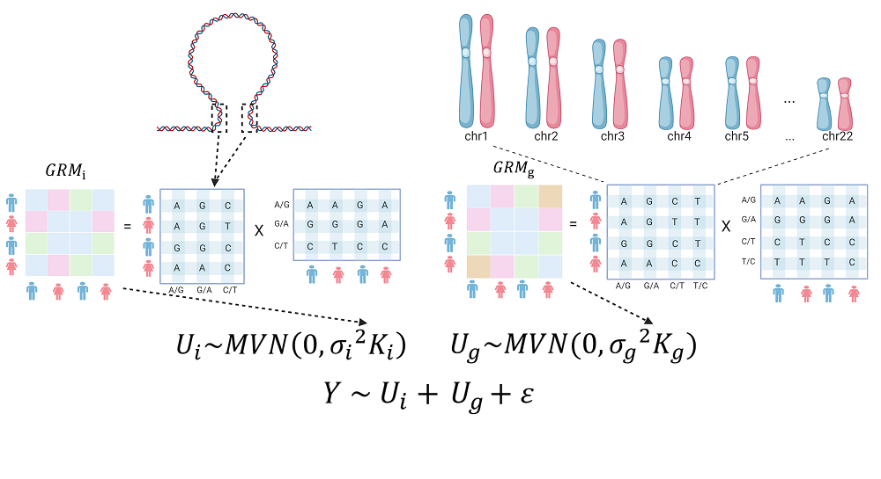

Slide 12
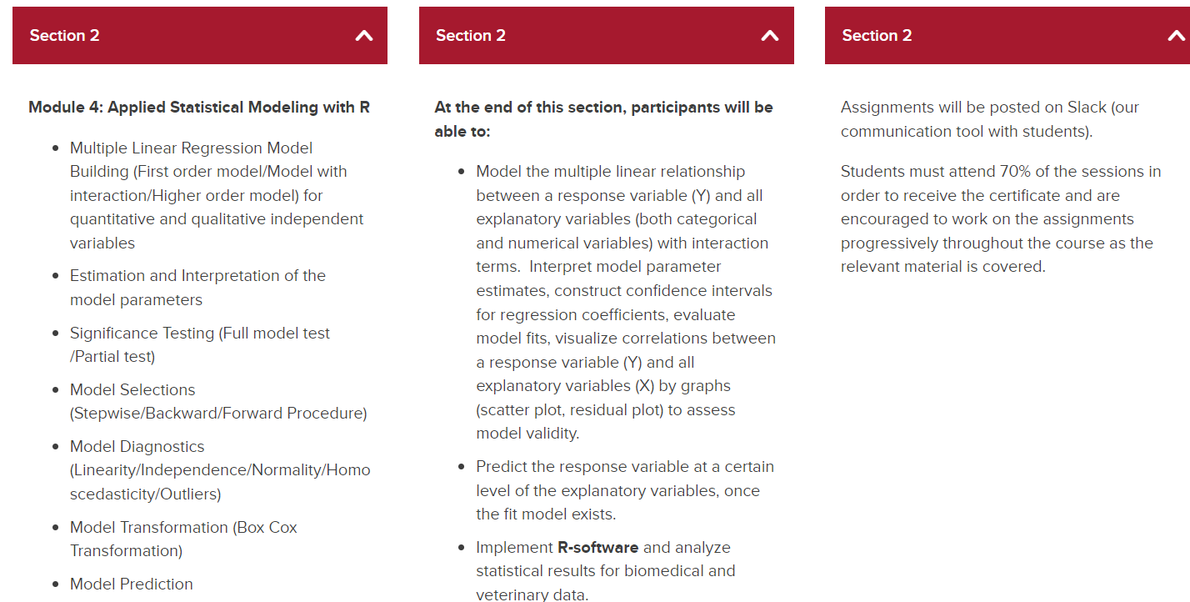
Data 603, May 23-June 2
Principles of Biostatistics | Research at UCalgary | University of Calgary
Section 2: Applied Statistical Modelling for Data Analysis in R, will cover basics of applied statistical modelling.
Section 2: May 23-June 2, 2023 | 27 hours (13.5 hours lecture + 13.5 hours lab)

Slide 13
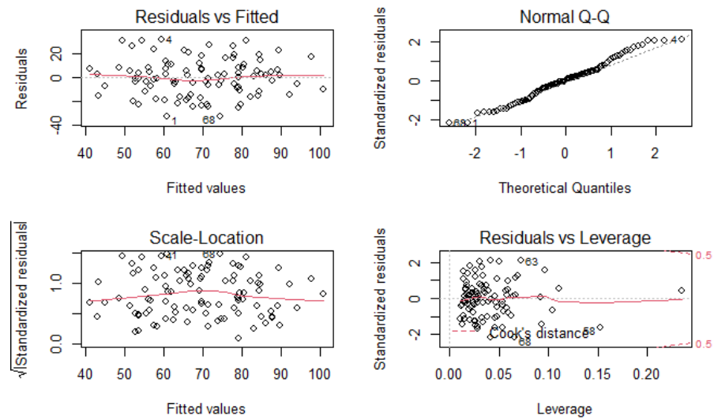
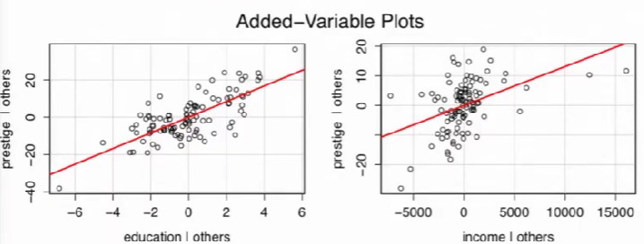
Workflow of regression analysis
State a hypothesis
Data exploration
Estimate a regression model
Diagnostics
Residual versus fitted plot, Normal QQ plots of residuals, Influence plot (residual vs. leverage), Added variable plots,
Fix the biggest problem and go back to 3. (e.g., remove some outliers points detected by leverage)
(Compare alternative models with nested model tests)
Interpret the regression coefficients: are the effects large, and what do they mean in your research context.

Slide 14
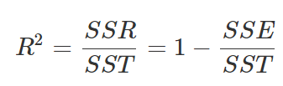
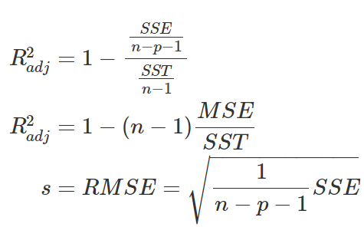
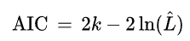
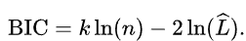
Outlines
MLRModellingPart1-ClassNotes (1st order model)
Hypothesis test; CI; Full/Partial model test (T-test, F-test); Model Fit (R^2, adjusted R^2); Model predict
MLRModellingPart2-ClassNotes (interaction model)
Individual Coefficients Test (t-test); Multiple Regression with Qualitative (Dummy) Variable Models (lm(y~factor(x1))); Interaction Effect in Multiple Regression with both Quantitative and Qualitative (Dummy) Variable Models; A Quadratic (Second-Order) Model with Quantitative Predictors
MLRModellingPart3-ClassNotes
Model selection.
Specify the maximum model to be considered (largest model, or restrictions of maximum model);
Specify a strategy for selecting a model (stepwise (y~X1, y~X2, Y~X1+X2), backward, forward); (Regression selection metrics: R^2, adjusted R^2, Mallows’s Cp Criterion, AIC and BIC).
Evaluate the reliability of the model chosen (involve interaction terms)
MLRModellingPart4-ClassNotes
Model diagnostic
Variance homo; Residual normality; predictors’ Multipcolineality;
Notes:
→ Stepwise
fullmodel<-lm(Y~X1+X2+factor(X3)+X4+X5+factor(X6)+X7+X8+factor(X9)+X10, data = salary)
summary(fullmodel)
stepmod=ols_step_both_p(fullmodel,pent = 0.1, prem = 0.3, details=TRUE)
summary(stepmod$model)
‘’’
pent: variables with p value less than pent will enter into the model.
prem: variables with p value more than prem will be removed from the model.
details: print the regression result at each step.
’’’
#R functions ols_step_both_p(): Build regression model from a set of candidate predictor variables by entering and removing predictors based on p values
→ Backward
fullmodel<-lm(Y~X1+X2+factor(X3)+X4+X5+factor(X6)+X7+X8+factor(X9)+X10, data = salary)
backmodel=ols_step_backward_p(fullmodel, prem = 0.3, details=TRUE)
summary(backmodel$model)
‘’’
The Backward procedure initially fits a model containing terms for all potential independent variables. The variable with the smallest t (or F) statistic for testing H0:βi=0 is identified and dropped from the model if the t-value is less than some specified critical value or p-value more than a cut-off.
’’’
→ Forward
#This method is nearly identical to the stepwise procedure previously outlined. The only difference is that the forward selection technique provides no option for rechecking the t-values corresponding to the XX’s that have entered the model in an earlier step.
Mallow’s Cp Criterion
Estimates the magnitude of bias present in predicted values when an important feature is missing; large residuals.
Model selection
Option 1:
Library(olsrr)
firstordermodel<-lm(Y~X1+X2+X3+X4+X5+X6+X7+X8+X9+X10, data= salary)
ks=ols_step_best_subset(firstordermodel, details=TRUE)
rsquare<-c(ks$rsquare)
AdjustedR<-c(ks$adjr)
cp<-c(ks$cp)
AIC<-c(ks$aic)
cbind(rsquare,AdjustedR,cp,AIC)
par(mfrow=c(2,2)) # split the plotting panel into a 2 x 2 grid
plot(ks$cp,type = "o",pch=10, xlab="Number of Variables",ylab= "Cp")
plot(ks$rsq,type = "o",pch=10, xlab="Number of Variables",ylab= "R^2")
plot(ks$aic,type = "o",pch=10, xlab="Number of Variables",ylab= "AIC")
plot(ks$adjr,type = "o",pch=10, xlab="Number of Variables",ylab= "Adjusted R^2")
Option 2:
library(olsrr)
firstordermodel<-lm(Y~X1+X2+X3+X4+X5+X6+X7+X8+X9+X10, data= salary)
library(leaps) #need to install the package leaps for regsubsets() function
best.subset<-regsubsets(Y~X1+X2+X3+X4+X5+X6+X7+X8+X9+X10, data= salary, nv=10 )
#by default, regsubsets() only reports results up to the best 8-variable model
#Model selection by exhaustive search, forward or backward stepwise, or sequential replacement
#The summary() command outputs the best set of variables for each model size using RMSE.
summary(best.subset)
reg.summary<-summary(best.subset)
# for the output interpretation
rsquare<-c(reg.summary$rsq)
cp<-c(reg.summary$cp)
AdjustedR<-c(reg.summary$adjr2)
RMSE<-c(reg.summary$rss)
BIC<-c(reg.summary$bic)
cbind(rsquare,cp,BIC,RMSE,AdjustedR)

Slide 15
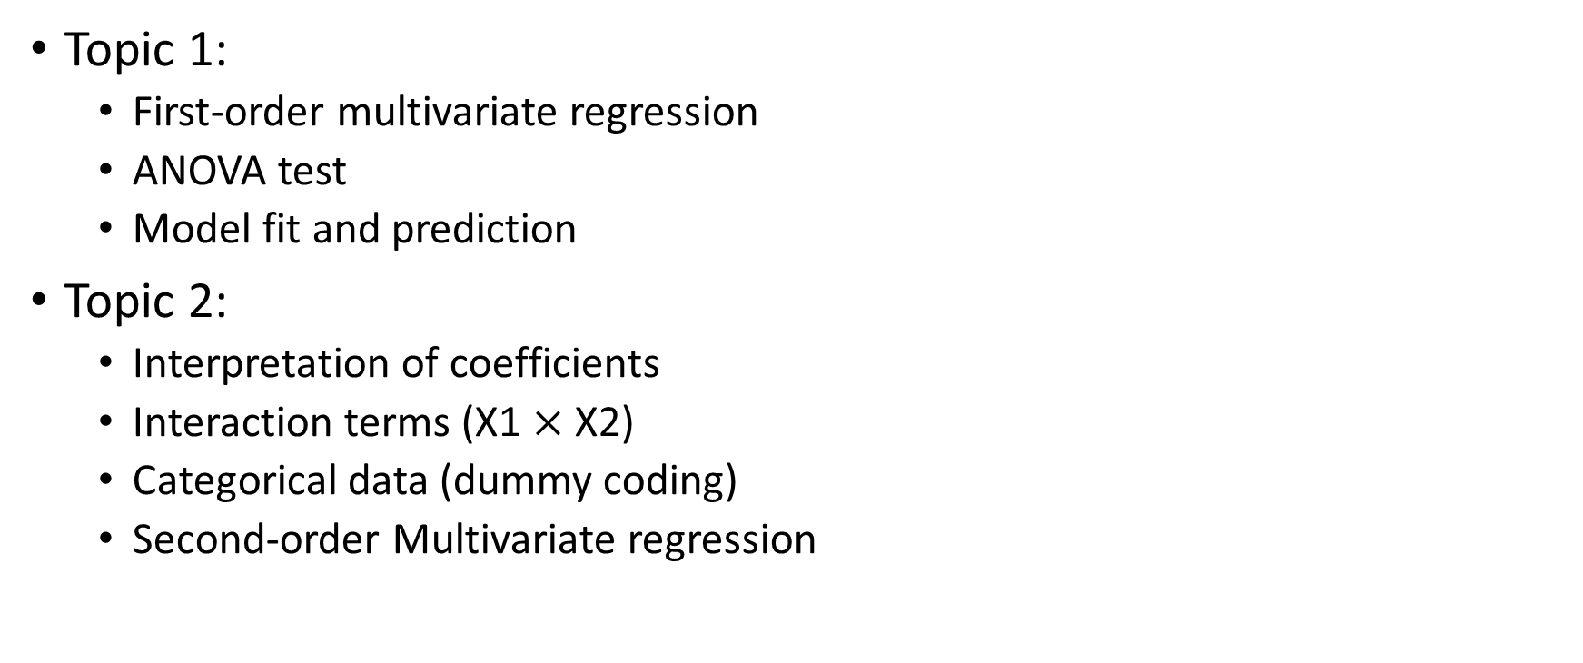
Topic 1-2: model building
Topic 1:
First-order multivariate regression
ANOVA test
Model fit and prediction
Topic 2:
Interpretation of coefficients
Interaction terms (X1 $×$ X2)
Categorical data (dummy coding)
Second-order Multivariate regression

Slide 16
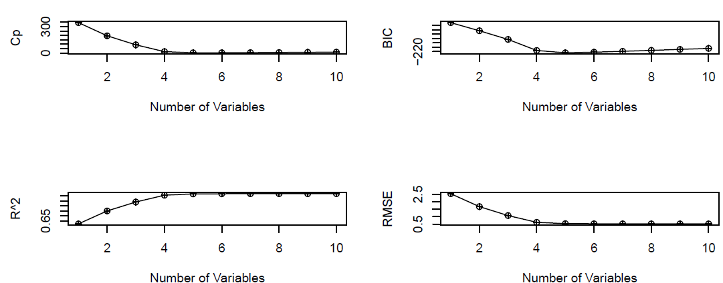
Topic 3: model selection
Step-wise selection
Backward
Forward
Model evaluation metrics

Slide 17
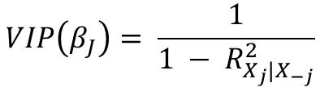
Topic 4: Model Diagnostic
$$VIP\left(β_{J}\right)= \frac{1}{1 − R_{X_{j}|X_{−j}}^{2}}$$
1. Linearity Assumption
The linear regression model assumes that there is a straight-line relationship between the predictors and the response. If the true relationship is far from linear, then virtually all of the conclusions that we draw from the fit are suspect. In addition, the prediction accuracy of the model can be significantly reduced. Residual plots are a useful graphical tool for identifying non-linearity.
2. Independence Assumption
An important assumption of the linear regression model is that the error terms, ϵ1,ϵ2,ϵ3,...,ϵn are uncorrelated (must be mutually independent). What does this mean? For instance, if the errors are uncorrelated, then the fact that ϵi is positive provides little or no information about the sign of ϵi+1.
The assumption of independent errors is violated when successive errors are correlated. This typically occurs when the data for both dependent and independent variables are observed sequentially over a period of time-called time-series data
We can check displays of the regression residuals for evidence of patterns, trends or clumping, any of which would suggest a failure of independence.
3. Equal Variance Assumption
Another important assumption of the linear regression model is that the error terms have constant variance (homoscedasticity), Var(ϵi)=σ2.
Breusch-Pagan test (H0: homo, Ha: hetero)
Bartlett’s test
4. Normality Assumption
The multiple linear regression analysis requires that the errors between observed and predicted values (i.e., the residuals of the regression) should be normally distributed. This assumption may be checked by looking at a histogram, a normal probability plot or a Q-Q-Plot.
Shapiro-Wilk normality test (H0: residuals follow normal distribution, Ha: residuals do not follow a normal distribution)
5. Multicollinearity
Often, two or more of the independent variables used in the model for E(Y) provide redundant information.
Variance Inflation Factor (VIF) (VIF>2, exists multicollinearity, Otherwise, no )
6. Outlier (The Effect on Individual Cases)
Residual and leverage plot
Notes:
3. How to deal with Heteroscedasticity?
Log-transformation. As the simple solver, log-transformation can be one of the candidates. When log() takes the numbers, the difference between big and small numbers relatively becomes small.
Box-Cox transformations. This will help the ‘transformed’ data to have equal variance, and, as usually happens, will also make the transformed data to follow a normal distribution.
Weight Least Squares Regression. If one wants to correct for heteroskedasticity by using a fully efficient estimator rather than accepting inefficient OLS and correcting the standard errors, the appropriate estimator is weight least squares, which is an application of the more general concept of generalized least squares.
5. Multicollinearity causes the following two basic types of problems:
The coefficient estimates can swing wildly based on which other independent variables are in the model. The coefficients become very sensitive to small changes in the model.
Multicollinearity reduces the precision of the estimate coefficients, which weakens the statistical power of your regression model. You might not be able to trust the p-values to identify independent variables that are statistically significant.
Testing for Multicollinearity with Variance Inflation Factors (VIF)
If you can identify which variables are affected by multicollinearity and the strength of the correlation, you’re well on your way to determining whether you need to fix it. Fortunately, there is a very simple test to assess multicollinearity in your regression model which is called “The variance inflation factor (VIF)”
The variance inflation factor (VIF)
Statistical software calculates a VIF for each independent variable. Value of VIFs start at 1 and have no upper limit and can be interpreted as following;
*VIFs=1 indicates that there is no collinearity between this independent variable and any others.
*1<= VIFs <=5 suggest that there is a moderate collinearity, but it is not severe enough to warrant corrective measures.
VIFs > 5 or 10 represent critical levels of multicollinearity where the coefficients are poorly estimated, and the p-values are questionable.
We use VIFs to identify correlations between variables and determine the strength of the relationships.
There are two simple solutions for multicolinearility
The first solution is to drop one of the problematic variables from the regression model. This can usually be done without much compromise to the regression model, since the presence of multicollinearity implies that the information that this variable provides about the response is redundant in the presence of the other variables.
The second solution is to combine the collinear variables together into a single predictor. For instance, we might take the average of standardized versions of Limit and Rating in order to create a new variable that measures credit worthiness.
6. Outlier
Some cases (samples) are influential to the regression model, and others are not. We watch out for outlying values at the upper right corner or at the lower right corner. Those spots are the places where cases can be influential against a regression line. Look for cases outside of a dashed line, Cook’s distance. When cases are outside of the Cook’s distance (meaning they have high Cook’s distance scores), the cases are influential to the regression results. The regression results will be altered if we exclude those cases.

Slide 18
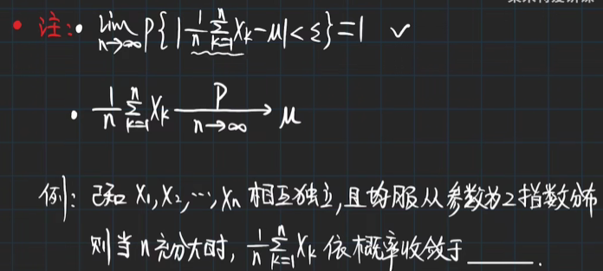
Hypothesis tests
Random variable: a variable depends on random events. It is a mapping or a function from possible outcomes in a sample space (H/T) to a measurable space (-1/1).
Central limited theory: when independent random variables are summed up, their properly standardized sum (sum-E(sum))/D(sum) tends toward a standardized normal distribution even if the original variables themselves are not normally distributed.
Large number law: the number of trials increases, and the average of the result will become closer to the expected value.
Power is the probability that the test rejects the null hypothesis given that the alternative hypothesis is true.
Power is fixed, effect size is fixed, how many samples do we need?
Libeary(pwr), d<-(mu-c)/sigma, pwr.norm.test(d=d, power=0.8, sig.level=0.05, alternative="greater") VS power.t.test(delta=2, sd=1, sig.level=0.05, power = 0.8, alternative="one.sided")

Slide 19
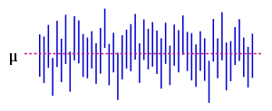
Confidence interval
Measurement of precision
The confidence interval is based on the observations from a sample, and hence differs from sample to sample. The likelihood that the parameter will be in the interval is called the confidence level, and the end points of the confidence interval are referred to as confidence limits.
The calculated interval has fixed endpoints, where μ might be in between (or not). Thus this event has probability either 0 or 1. We cannot say: "with probability (1 − α), the parameter μ lies in the confidence interval." We only know that by repetition in 100(1 − α) % of the cases, μ will be in the calculated interval. In 100α % of the cases, however, it does not. And unfortunately we do not know in which of the cases this happens. That is why we say: "with confidence level 100(1 − α) %, μ lies in the confidence interval.“
The figure on the right shows 50 realizations of a confidence interval [can be long or short] for a given population mean μ. 95% confidence interval for mu requires 100 realizations, 95 realizations CI contains true mu and 5 not.

Slide 20
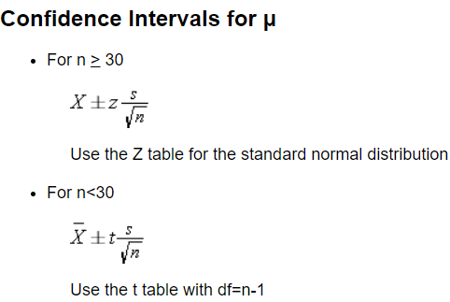
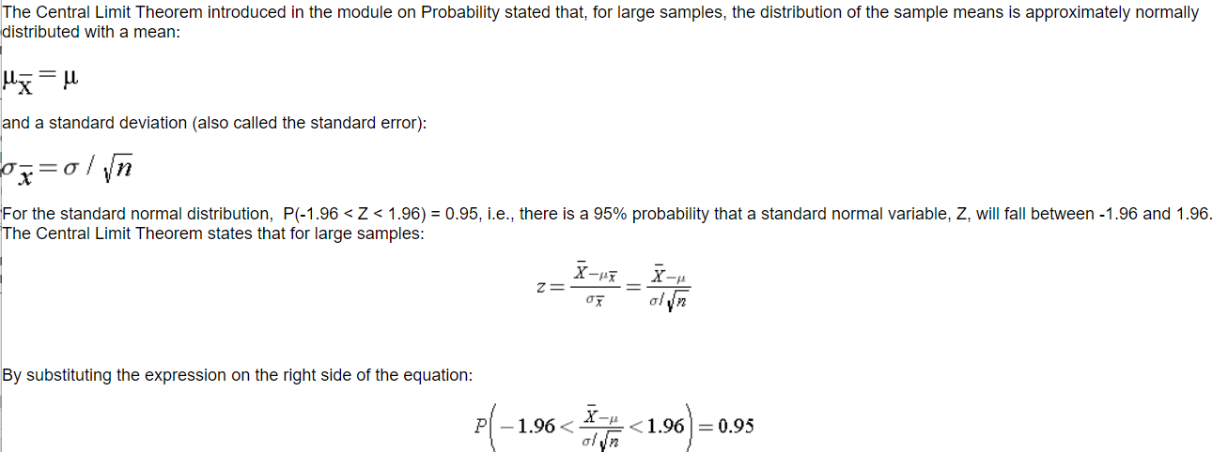
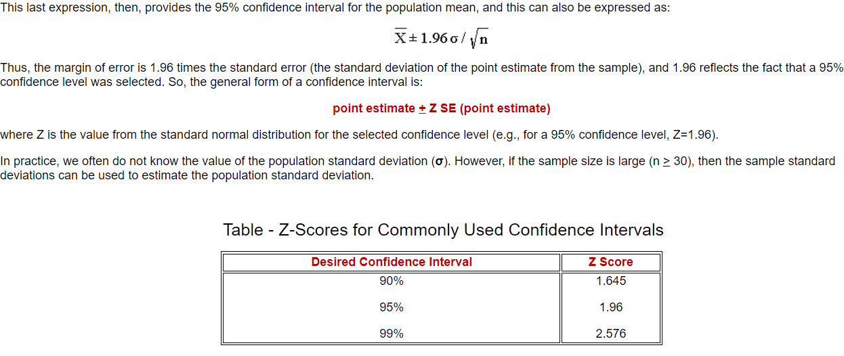
Confidence interval
Confidence Intervals for One Sample: Continuous Outcome, s is a standard division from one sample
Strictly speaking, a 95% confidence interval means that if we were to take 100 different samples and compute a 95% confidence interval for each sample, then approximately 95 of the 100 confidence intervals will contain the true mean value (μ).
https://www.geeksforgeeks.org/how-to-find-confidence-intervals-in-r/
Notes:
The confidence interval does not reflect the variability in the unknown parameter. Rather, it reflects the amount of random error in the sample and provides a range of values that are likely to include the unknown parameter. Another way of thinking about a confidence interval is that it is the range of likely values of the parameter (defined as the point estimate + margin of error) with a specified level of confidence (which is similar to a probability).

Slide 21
Model build
T-test: summary(lm(y~x1+x2+x3))
F-test: annova (reduced_model, full_model)
Process:
1. start with the Full model
2. Remove any predictors whose coefficients are not significant in the t-test
3. Use partial F test to confirm
4. Try a smaller model (remove another variables that you think might be marginal)
5. Use partial F to confirm against the full model

Slide 22
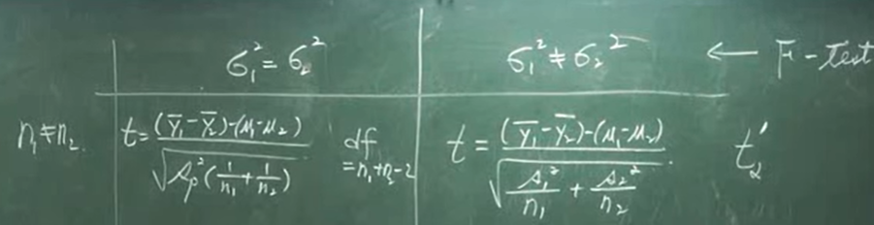
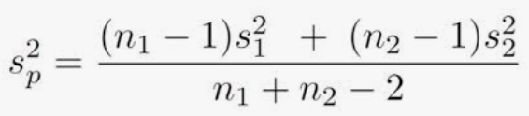
T-test
Two sample t-test, test whether two populations means equal or not.

Slide 23
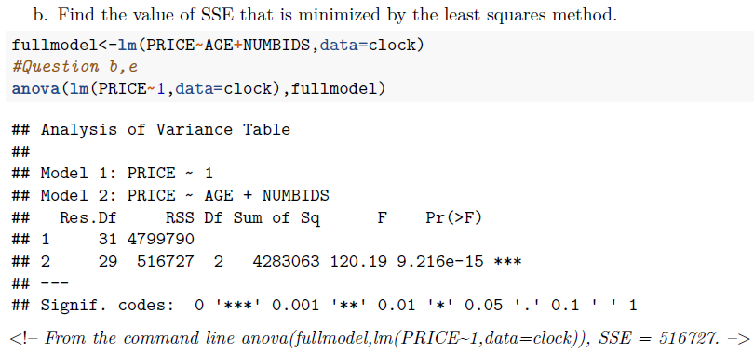
F-test
F value in ANOVA
F value in regression
H0: all of the regression coefficients are equal to zero.
ANOVA(null_model, full_model)
Partial F-test:
H0: all reduced variables have regression coefficients equal to 0. ANOVA(reduced_model, full_model)

Slide 24
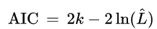
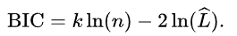
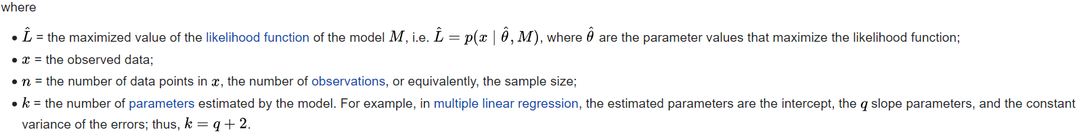
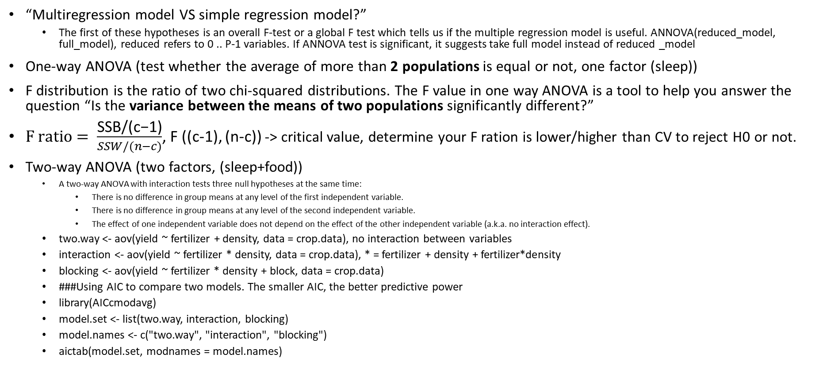
ANOVA
“Multiregression model VS simple regression model?”
The first of these hypotheses is an overall F-test or a global F test which tells us if the multiple regression model is useful. ANNOVA(reduced_model, full_model), reduced refers to 0 .. P-1 variables. If ANNOVA test is significant, it suggests take full model instead of reduced _model
One-way ANOVA (test whether the average of more than 2 populations is equal or not, one factor (sleep))
F distribution is the ratio of two chi-squared distributions. The F value in one way ANOVA is a tool to help you answer the question “Is the variance between the means of two populations significantly different?”
$F ratio= \frac{\text{SSB}\text{/(}\text{c}\text{−1)}}{SSW/(n−c)}$, F ((c-1), (n-c)) -> critical value, determine your F ration is lower/higher than CV to reject H0 or not.
Two-way ANOVA (two factors, (sleep+food))
A two-way ANOVA with interaction tests three null hypotheses at the same time:
There is no difference in group means at any level of the first independent variable.
There is no difference in group means at any level of the second independent variable.
The effect of one independent variable does not depend on the effect of the other independent variable (a.k.a. no interaction effect).
two.way <- aov(yield ~ fertilizer + density, data = crop.data), no interaction between variables
interaction <- aov(yield ~ fertilizer * density, data = crop.data), * = fertilizer + density + fertilizer*density
blocking <- aov(yield ~ fertilizer * density + block, data = crop.data)
###Using AIC to compare two models. The smaller AIC, the better predictive power
library(AICcmodavg)
model.set <- list(two.way, interaction, blocking)
model.names <- c("two.way", "interaction", "blocking")
aictab(model.set, modnames = model.names)

Slide 25
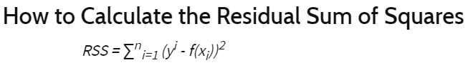
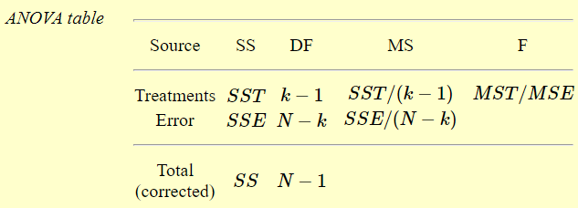
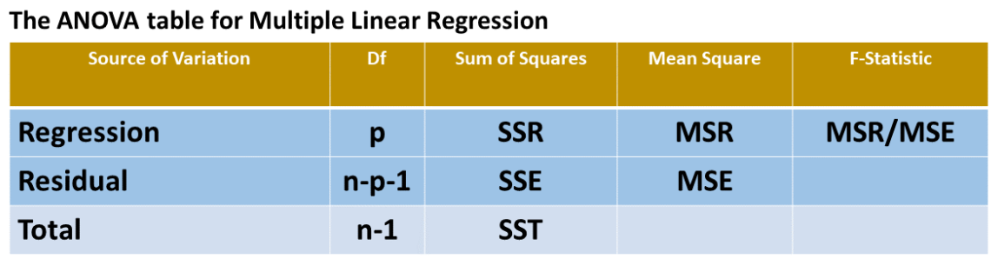
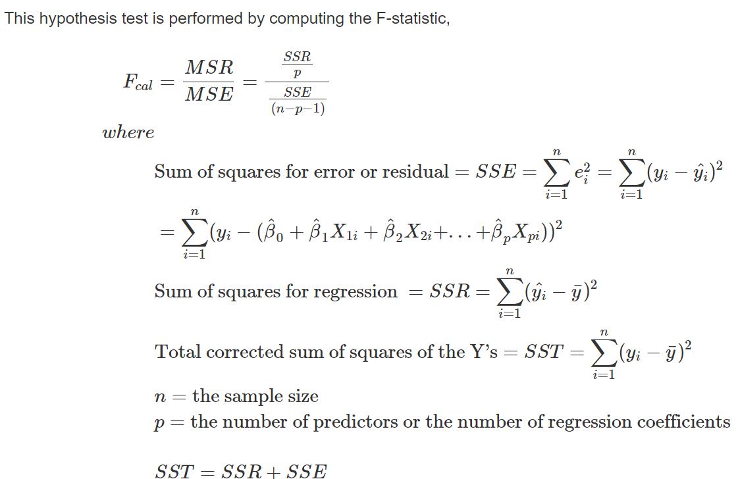
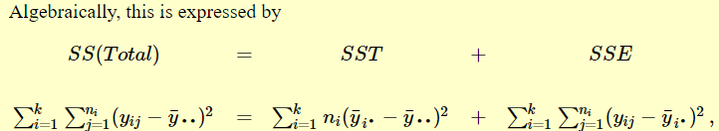
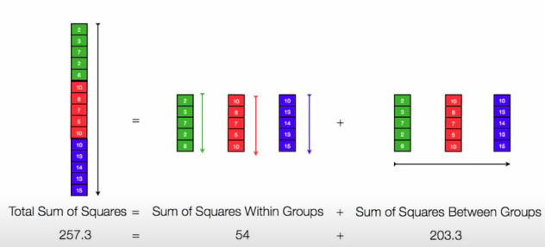
/SSB
/SSW
SSE: Sum of Squared Errors = RSS = SS within the group ( each value -each group mean)
SST: Sum of Squared Errors Treatments = SS between groups (each group mean – total mean)
SS: Sum of Squared errors total (each value – total mean)

Slide 26
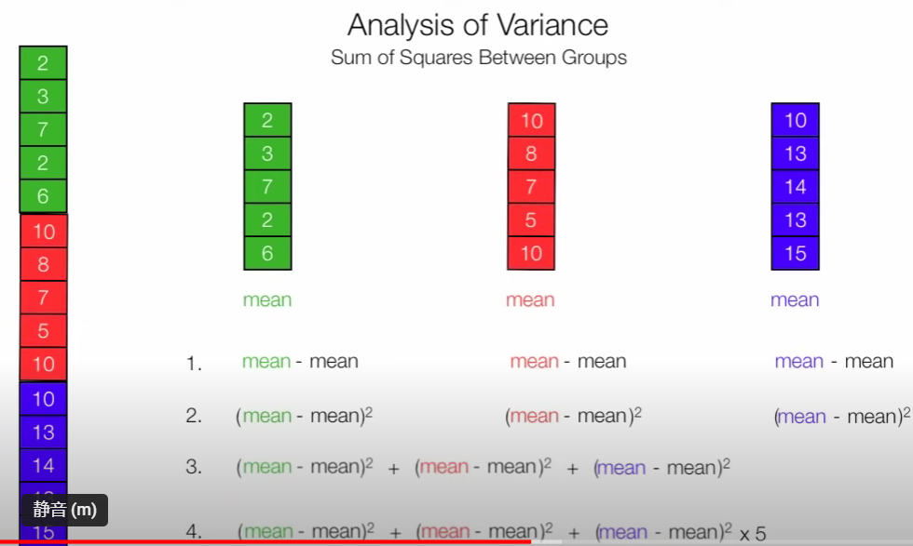
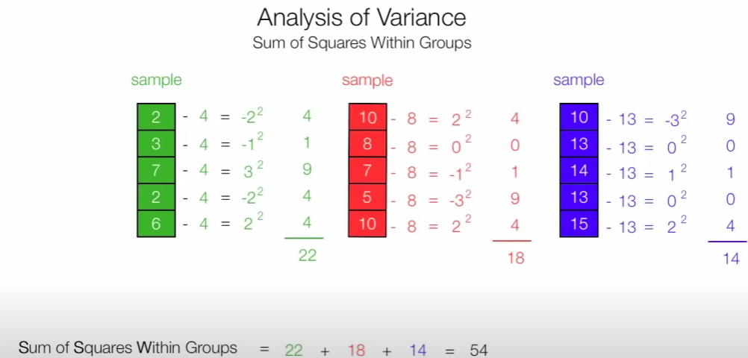
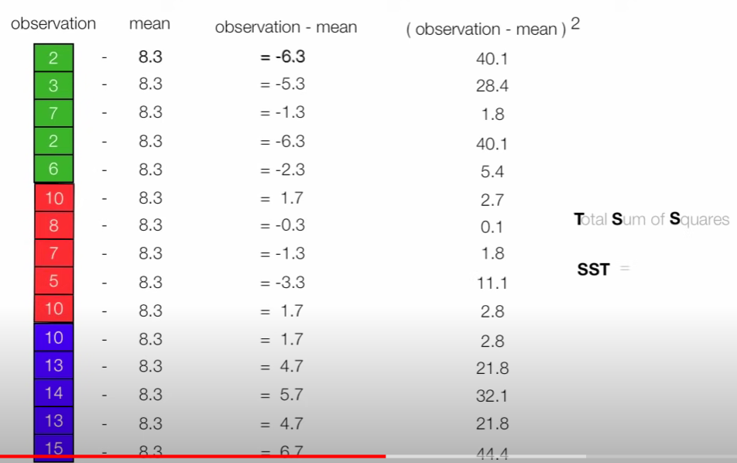

Slide 27
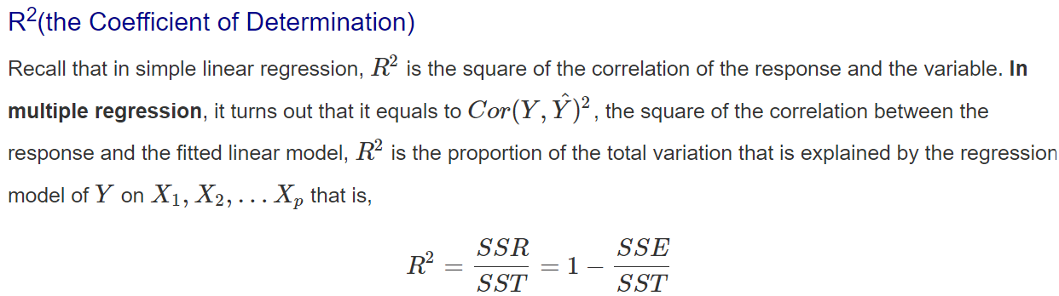
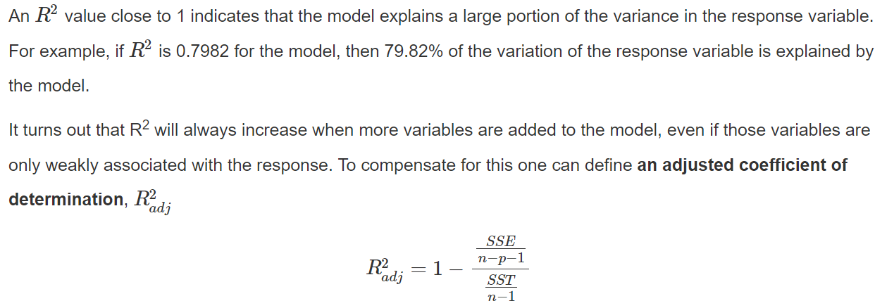
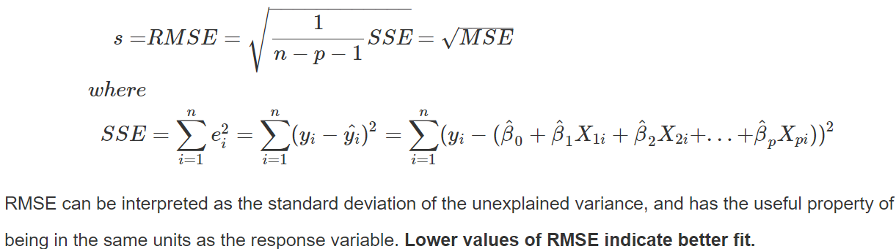
Model Fit
full<-lm(sale~tv+radio+newspaper, data=Advertising)
reduced<-lm(sale~tv+radio, data=Advertising)
summary(full)$r.squared
summary(reduced)$r.squared
summary(full)$adj.r.squared
summary(reduced)$adj.r.squared
full<-lm(sale~tv+radio+newspaper, data=Advertising)
reduced<-lm(sale~tv+radio, data=Advertising)
sigma(full) # RMSE for the full model
sigma(reduced) # Rmse for the reduced model

Slide 28
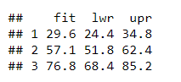
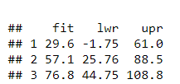
Model Prediction
reduced<-lm(sale~tv+radio, data=Advertising)
newdata = data.frame(tv=200, radio=20)
predict(reduced,newdata,interval="predict")
To display the 95% confidence intervals around the mean the predictions, specify the option interval = "confidence":
predict(model, newdata = new.speeds, interval = "confidence")
For example, the 95% confidence interval associated with a speed of 19 is (51.83, 62.44). This means that, according to our model, a car with a speed of 19 mph has an average stopping distance ranging between 51.83 and 62.44 ft. [for coefficient of predictor]
The prediction interval gives uncertainty around a single value. In the same way, as the confidence intervals, the prediction intervals can be computed as follow:
predict(model, newdata = new.speeds, interval = "prediction")
The 95% prediction intervals associated with a speed of 19 is (25.76, 88.51). This means that, according to our model, 95% of the cars with a speed of 19 mph have a stopping distance between 25.76 and 88.51.

Slide 29
Multiple Regression with Qualitative (Dummy) Variable Models
These coded qualitative variables are called dummy variables or categorical predictor variables, since the number assigned to the various levels are arbitrarily selected.
factor() : command will make sure that R knows that your variable is categorical. This is especially useful if your categories are indicated by integers, otherwise function lm() might interpret the variable as continuous.
dummymodel<-lm(Balance~factor(Gender),data=credit)
summary(dummymodel)

Slide 30
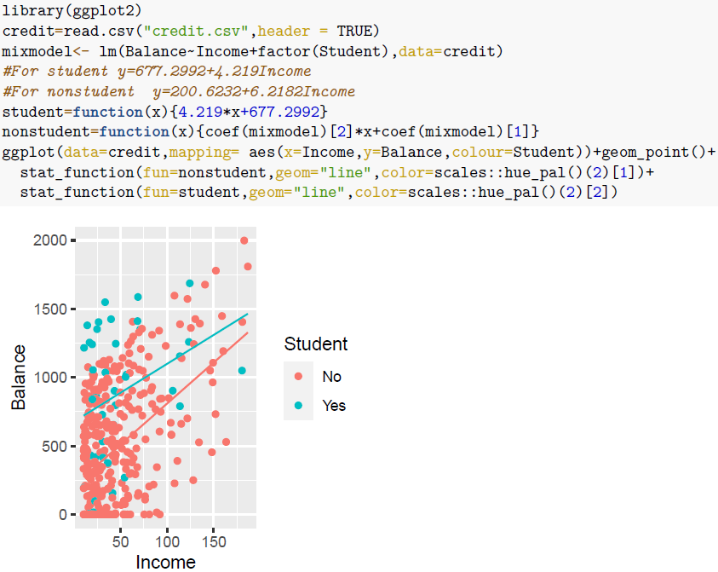
Interaction terms

Slide 31
A Quadratic (Second-Order) Model with Quantitative Predictors

Slide 32
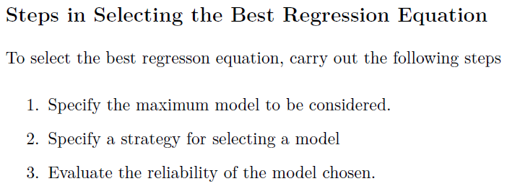
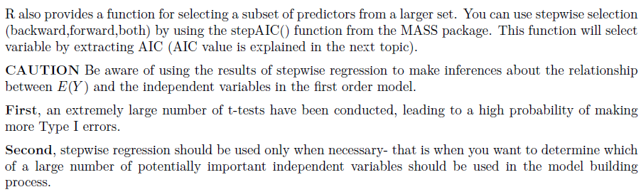
Model selection

Slide 33
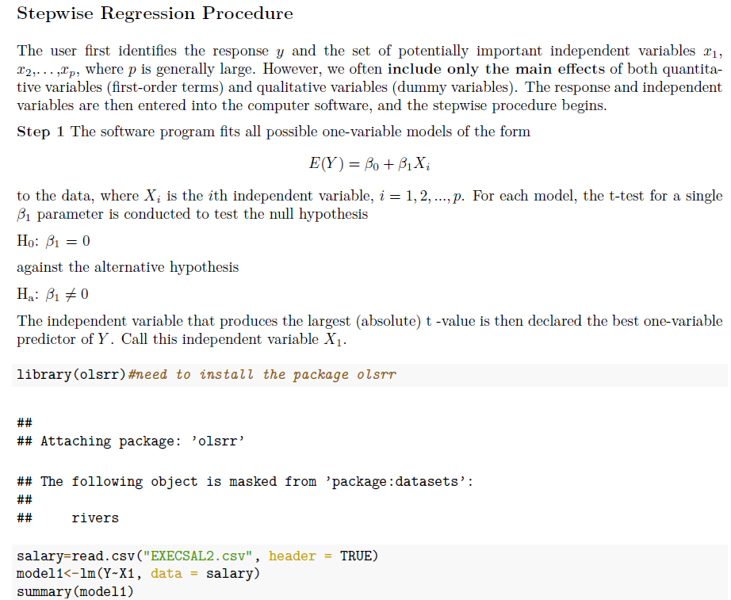
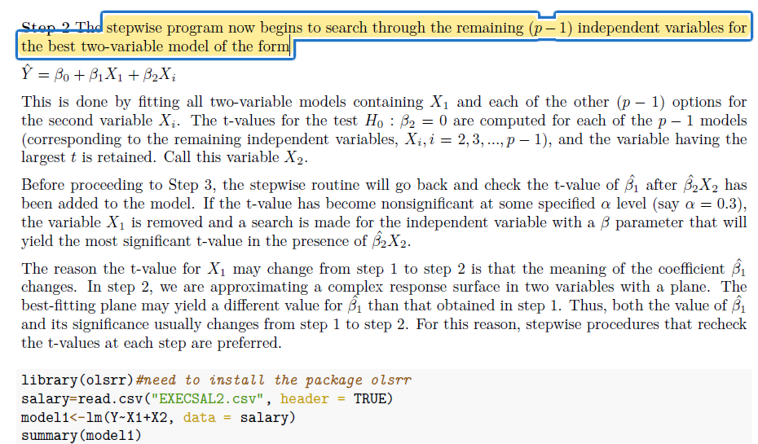
Stepwise Regression Procedure

Slide 34
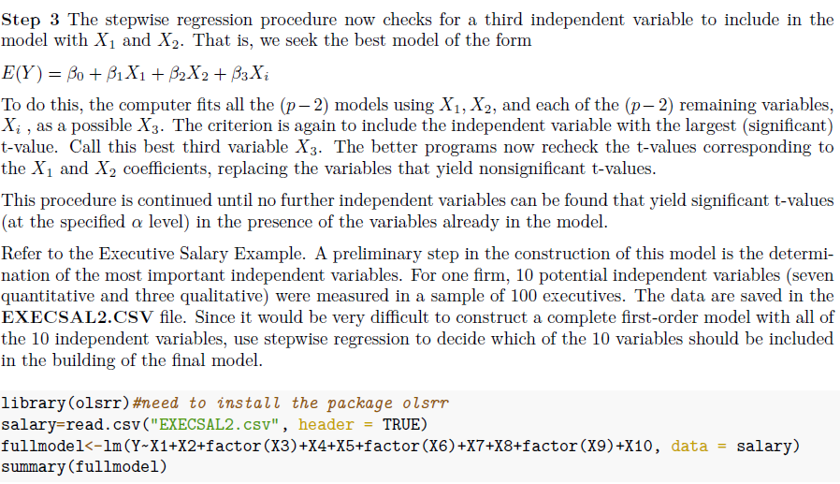
stepmod=ols_step_both_p(fullmodel,pent = 0.1, prem = 0.3, details=TRUE)
summary(stepmod$model)

Slide 35
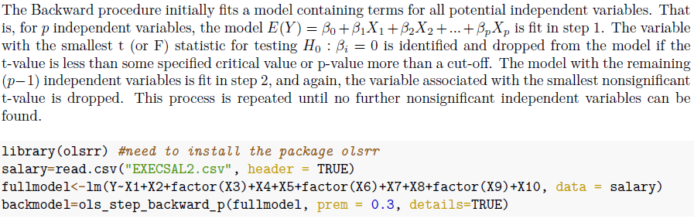
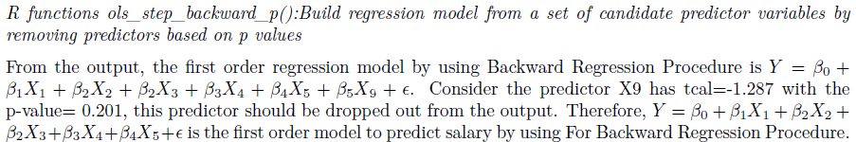
Backward Elimination Procedure
summary(backmodel$model)

Slide 36
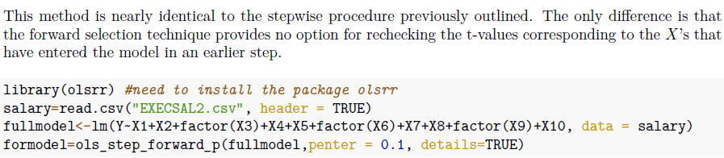

Forward selection procedure

Slide 37



All-Possible-Regressions Selection Procedure
1. MSE
2. Adjusted R2

Slide 38




Mallow’s Cp
The Cp criterion, named for Colin Lingwood Mallow, selects as the best subset model with
a small value of Cp (i.e., a small total mean square error), means that the model is relatively precise.
a value of Cp near p + 1, a property that indicates that slight (or no) bias exists in the subset regression model.
Thus, the Cp criterion focuses on minimizing total mean square error and the regression bias.

Slide 39
Evaluate the reliability of the model chosen
After using model selection by automatic methods or all possible regression methods, we might not have the best fit model yet, as we consider only main effects on independent variables. After eliminating some variables that are not important out of the model, we consider interaction terms and/or high order multiple regression model to improve the model.
interacmodel<-lm(Y~(X1+X2+factor(X3)+X4+X5)ˆ2,data = salary)
summary(interacmodel)
#considering high order model between Xs and Y to improve the model
library(GGally) # need to install the GGally package for ggpairs function
salarydata <-data.frame(salary$Y,salary$X1,salary$X2,salary$X3,salary$X4,salary$X5)
Salarydata

Slide 40

4. Diagnostics
Residuals can be used as estimate of the error terms

Slide 41







Linearity assumption
1. Linearity assumption: Residual plots
straight-line relationship between the predictors and the response

Slide 42
Independence Assumption
Independence assumption: Residual VS Fits
An important assumption of the linear regression model is that the error terms, ϵ1, ϵ2, ϵ3, ..., ϵn are uncorrelated. [Not for time series data]
displays of the regression residuals for evidence of patterns, trends or clumping, any of which would suggest a failure of independence. In the special case when response Y is related to time.

Slide 43



Equal variance assumption
1. Check “Residual VS Fitted” plots
2. Conduct Heteroscedasticity test
Conduct a test for heteroscedasticity (non constant varaince) and plot a residual plot.
#Heteroscedasticity test
#H0:heteroscedasticity is not present, constant variance
#Ha:heteroscedasticity is present, not constant variance
bptest(finalintermodel), #studentized Breusch-Pagan test
in the presence of heteroscedasticity, play with the power of items; then bptest again.

Slide 44


Equal variance assumption
Many statistical tests (like a one-way ANOVA) assume that variances are equal across samples. Bartlett’s test can be used to verify that assumption.
This test uses the following null and alternative hypotheses:
H0: The variance among each group is equal.
HA: At least one group has a variance that is not equal to the rest.
The test statistic follows a Chi-Square distribution with k-1 degrees of freedom where k is the number of groups.

Slide 45

Equal variance assumption
Box-Cox Transformations (Transformations for Nonnormallity and Heteroscedasticity)

Slide 46

Equal variance assumption
library(Ecdat)#for dataset University
reg=lm(nassets~stfees,data=University)
summary(reg)
#Testing for Homoscedasticity
library(lmtest)
bptest(reg)
#Testing for Normality
shapiro.test(residuals(reg))
library(MASS) #for the boxcox()function
bc=boxcox(reg,lambda=seq(-1,1))
#extract best lambda
bestlambda=bc$x[which(bc$y==max(bc$y))]
bestlambda
BOX-COX transformation

Slide 47

Equal variance assumption
Generalized least squares regression
Improving model by using Log(tv), but not recommended
Notes:
Not explain much about GLS. How about using glm function?

Slide 48


Normality assumption
1. Plot “Residuals”
2. #Testing for Normality
#Ho:the residuals are significantly normally distributed
#HA:the residuals are not significantly normally distributed
shapiro.test(residuals(finalintermodel))

Slide 49




Multicollinearity (predictors)
Problems exist when serious multicollinearity presents
Testing for Multicollinearity with Variance Inflation Factors (VIF)

Slide 50

Outliers
An outlying case is defined as a particular observation (Y,X1,X2, ...Xp) that differs from the majority of the cases in the data set. There are several ways we can find and evaluate outliers or influential points.
1. Residuals vs Leverage plot
This plot helps us to find influential cases (i.e., subjects), if any.
Outliers are not necessary influential

Slide 51

Outliers

Slide 52

Outliers

Slide 53
Plot(model)
model=lm(BURDEN~(CGDUR+ MEM +SOCIALSU) , data=KBI)
summary(model)
par(mfrow=c(2,2))
plot(model)
bptest(model)
shapiro.test(residuals(model))
(1,1) allows us to test nonlinearity and Heteroscedasticity
(1,2) allows us to test residuals are normally distributed.
(2,2) allows use detect outliers (Leverage is the distance from the mass center of the data; Cook’s distance is an overall measure of influence of an observation)
homoscedasticity:
By checking the residual plot (1,1), the magnitude of the residuals does not tend to increase with the fitted values.
Breusch Pagan test confirms that assumption as the pvalue is larger that 0.05.
linearity: regression residuals for evidence of patterns or trends, we found that the residual plot shows no discernible pattern or trend at all. (1,1)
normality: holds (a look at the normal Q-Q plot) and the test of Shapiro confirms that assertion
Outliers: Cook’s distance and Residual VS Leverage

Slide 54
Likelihood
What is likelihood:
The density (continues) or mass function that are associated to the observed data.
L(Θ, x) = f(x|Θ)
We need to find the right density (or mass) function that is mostly likely to have produced the observed data (among all other possible densities).
Notes:
Data
Plot data -> it may follow normal distribution. [Assumption: data follow normal distribution, you can write the density function from normal distribution]
We are interested in getting the values of paratermers that can maximize the probability of observing your data.

Slide 55
The method mle
The negative log likelihood function
The initial values of the parameters
The methods
“Nelder-Mead”, “BFGS”, “CG”, “L-BFGS-B”, “SANN”, “Brent”.
Sometimes the upper and lower limits of the parameters, depending on the type of method.
Use ?optim to understand these methods.
Example
The data:
y=rnorm(10000, mean=10, sd=5)
The likelihood:
nLL <- function(mean, sd) -sum(dnorm(y, mean, sd, log=TRUE))
The starting values
mean=15, sd=1
The method
L-BFGS-B
fit0 <- mle(nLL, start = list(mean = 15, sd= 1), method = "L-BFGS-B")

Slide 56



Linear regression
Lm()
glm_pass=glm(pass~hours, family=binomial(link='logit’))
Partial F test to compare two models: anova(reduced_model, full_model)
95% confidence interval. confint(model)
F partial test sig → reduced variables have at least non-zero beta
F partial test not sig → reduced variables all have zeros betas

Slide 57
What is power?
How likely one can detect the genuine signal?
What factors impact the power of our design?
Sample size
Effect size
Difference between the means (if this is the target fo the test)
Sample variance
Significant level (type I error)
Two-sided or one-sided

Slide 58


Traditional power analysis: closed form derivations
First we need to know the distance between the H0 and H1.
Non-centrality parameter (NCP) is the key parameter denoting that “distance”.
Details on how to derive NCP is omitted in this course, however please be aware it exists and plays critical roles
The simplest case will be Z-test based on normal distribution:
This test statistic follows a normal distribution.
What will be our power if the alternative hypothesis has the same variance and a higher mean μ₁?
where
H0
H1
μ0
μ1
Effect size = (μ₁-μ₀)/σ

Slide 59
Math derivations (sorry)
TIE is 0.05, so critical value = qnorm(1-TIE)
First qnorm(0.95) = 1.645 is our critical_value.
φ is the probability function for a standard normal (pnorm in R).
d is our test statistic.
Power = P(reject H₀| μ=μ₁) // definition of power
= P(test_stat > critical_value| μ=μ₁) // condition of rej
= P((d-μ₀)/(σ/√n) > critical_value| μ=μ₁) // def of stat
= P((d-μ₀)/(σ/√n) > 1.645| μ=μ₁) // critical value
= P((d-μ₁)/(σ/√n)> - (μ₁-μ₀)/(σ/√n)+1.645|μ=μ₁) // μ₁
= 1 – φ (- (μ₁-μ₀)/(σ/√n)+1.645) // def of density centered by μ₁
library(pwr)
pwr.norm.test(d=1/2, sig.level=0.05, power=0.8, alternative="greater")
power.t.test(delta=2, sd=1, sig.level=0.05, power = 0.8, alternative="one.sided")
Notes:
qnorm(1-critical_value, n, sd), n, sd)

Slide 60

Least Squares Method
Ordinary Least Squares regression (OLS) is a common technique for estimating coefficients of linear regression equations which describe the relationship between one or more independent quantitative variables and a dependent variable (simple or multiple linear regression). Least squares stand for the minimum squares error (SSE). Maximum likelihood and Generalized method of moments estimator are alternative approaches to OLS.
Assume the independence of variables
Genialized Least Square (GLS)
Work with glm as glm can accept a description of the error distribution

Slide 61


Slide 62


Slide 63


Slide 64


Slide 65


Slide 66



Slide 67



Slide 68

The above red sentence is incorrect because it assumes some randomness in the population means. However, this is not the case. The correct way to say this is that: there is a 95% probability that the sample mean is within so-and-so distance from the population mean.

Slide 69






